Slide 1

Data Science Project
Réalisé par:
Abir BEN HAJ YOUSSEF
Data Science Engineer, ENSI
abir.belhajyoussef@ensi-uma.tn
Phone: +216 93 189 062
Linkedin:
https://www.linkedin.com/in/abir-b/
https://github.com/abirbhy

Slide 2
Steps followed
Data Exploration
Data Cleaning
Feature Selection
Feature Engineering
Prediction model
2

Slide 3
Data exploration & cleaning
Dataset’s shape: (20, 1311) with a Target column that can take 0 (1000) or 1
(311) ➔ It is a binary classification problem, imbalanced dataset.
There are 3 columns with missing values (0,16% du dataset).
Convert categorical variables to numerical ones (X1, X3, X5, X10).
Drop X11 from dataset because it presents high correlation: X11-X13 0.985131.
Show the features importance to the user using xgboost and f1_score.
Feature selection & engineering
3

Slide 4
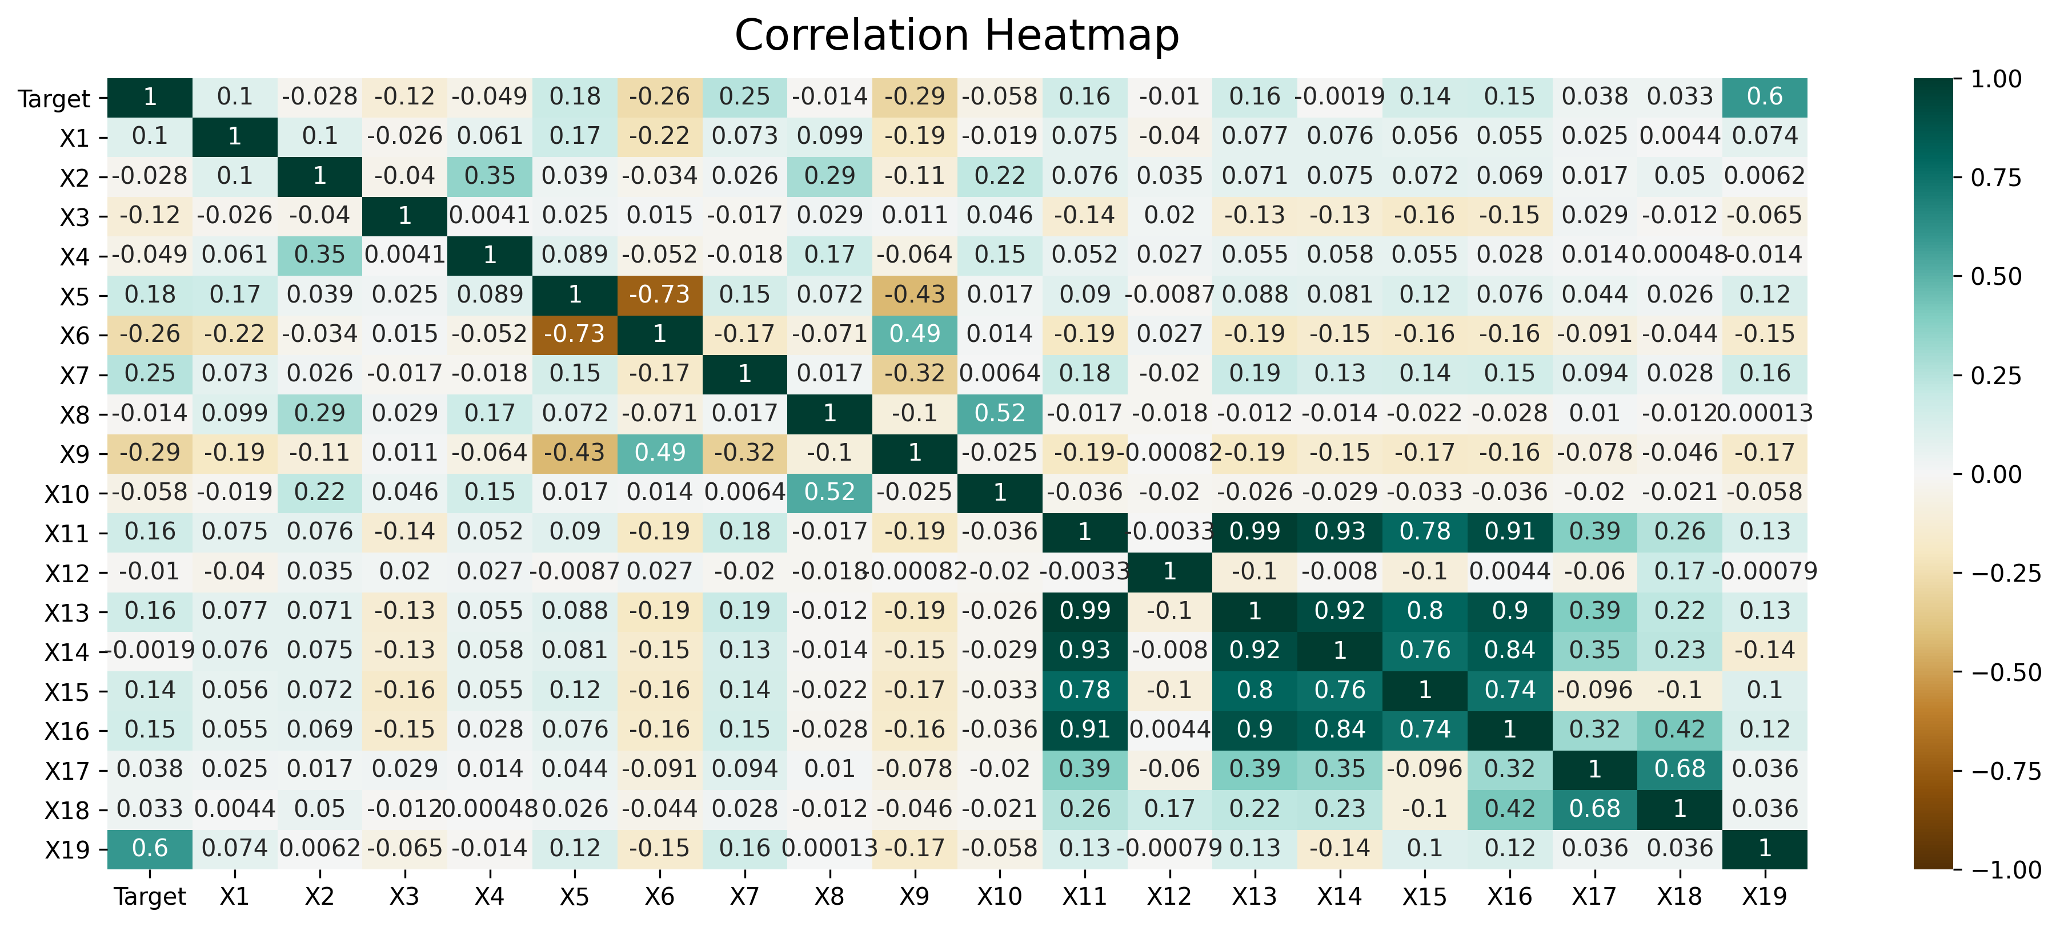

Slide 5
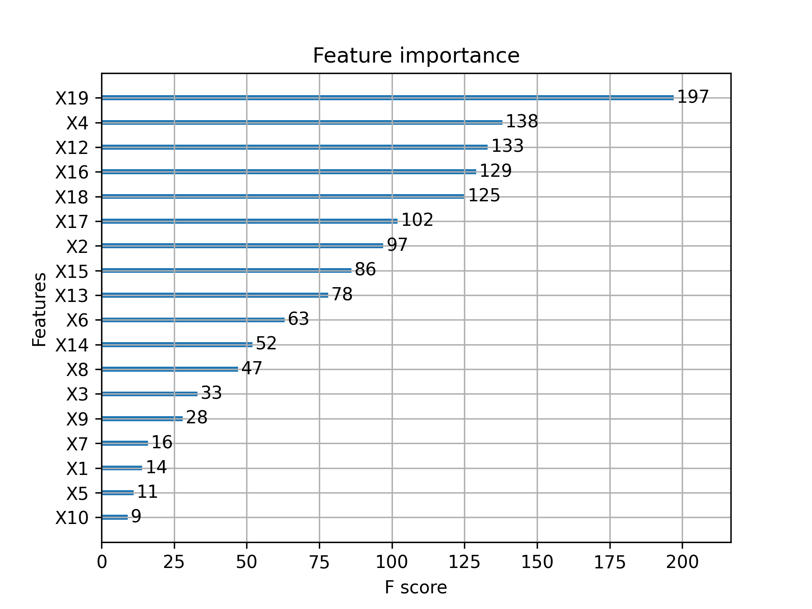

Slide 6
Prediction models
Cross Validation: auto takes care of the class imbalance while splitting.
Fit and evaluate the 4 chosen models (RandomForest, KNeighbors, SupportVector, GaussianNB) with cross-validation on the whole training set.
Make predictions on the test set and get the predicted probabilities.
Imbalanced dataset: Accuracy is not an efficient metric (the proportion of predictions that the model classified correctly): a model which classifies all testing samples into “0” will have an excellent accuracy (99.8%).
precision (how many are correctly classified among that class), recall (how many of this class you find over the whole number of element of this class), f1_score (the harmonic mean of precision and recall).
Evaluation
6

Slide 7
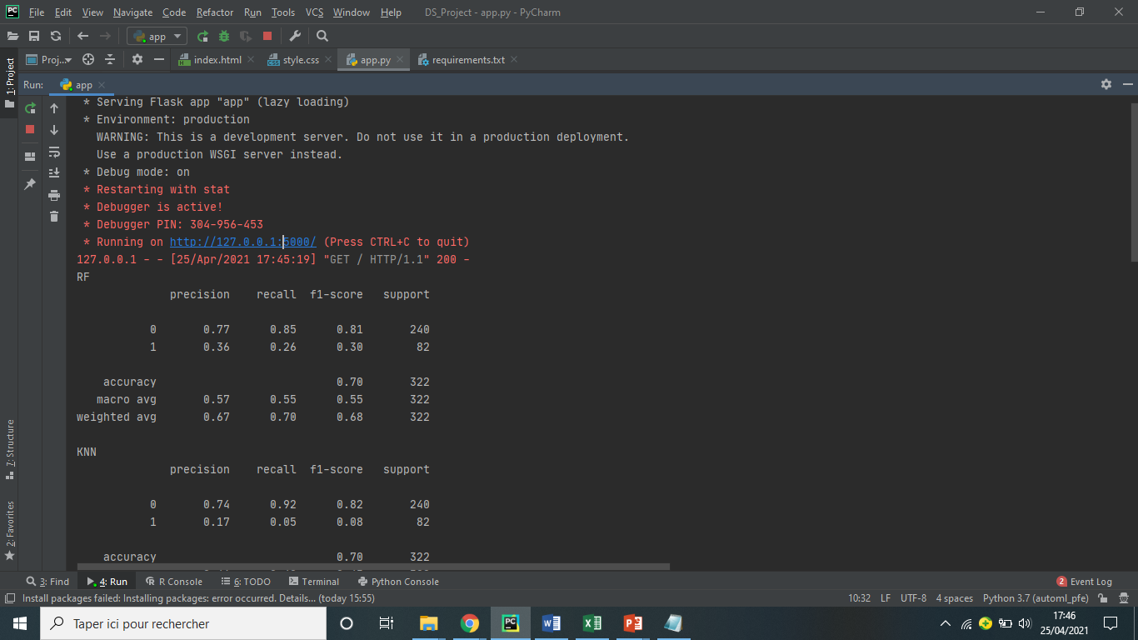

Slide 8
How to run the project?
Install all libraries in the requirements.txt file and execute app,py file (python3 app,py in cmd).
Go to http://127.0.0.1:5000/ url.
Choose 4-6 features you consider relevant and enter their values in this format: X11=900000 X12=221 X13=8161 X14=1084000 X15=13593 X16=1054170.
Click on Predict button. Now, you can see the predicted target for each classifier (['RF', 0, ';', 'KNN', 0, ';', 'SVM', 0, ';', 'GNB', 0]), in addition to a benchmark of models ordered by classification metrics and time in a format of 2 boxplots.
8

Slide 9




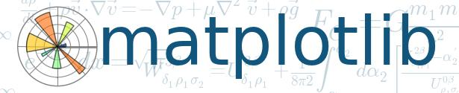
Results achieved
9

Slide 10
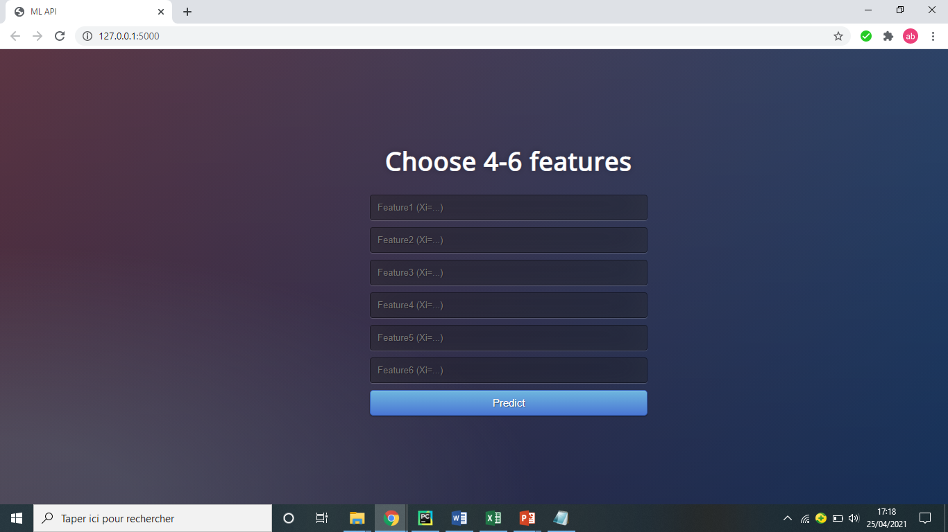

Slide 11
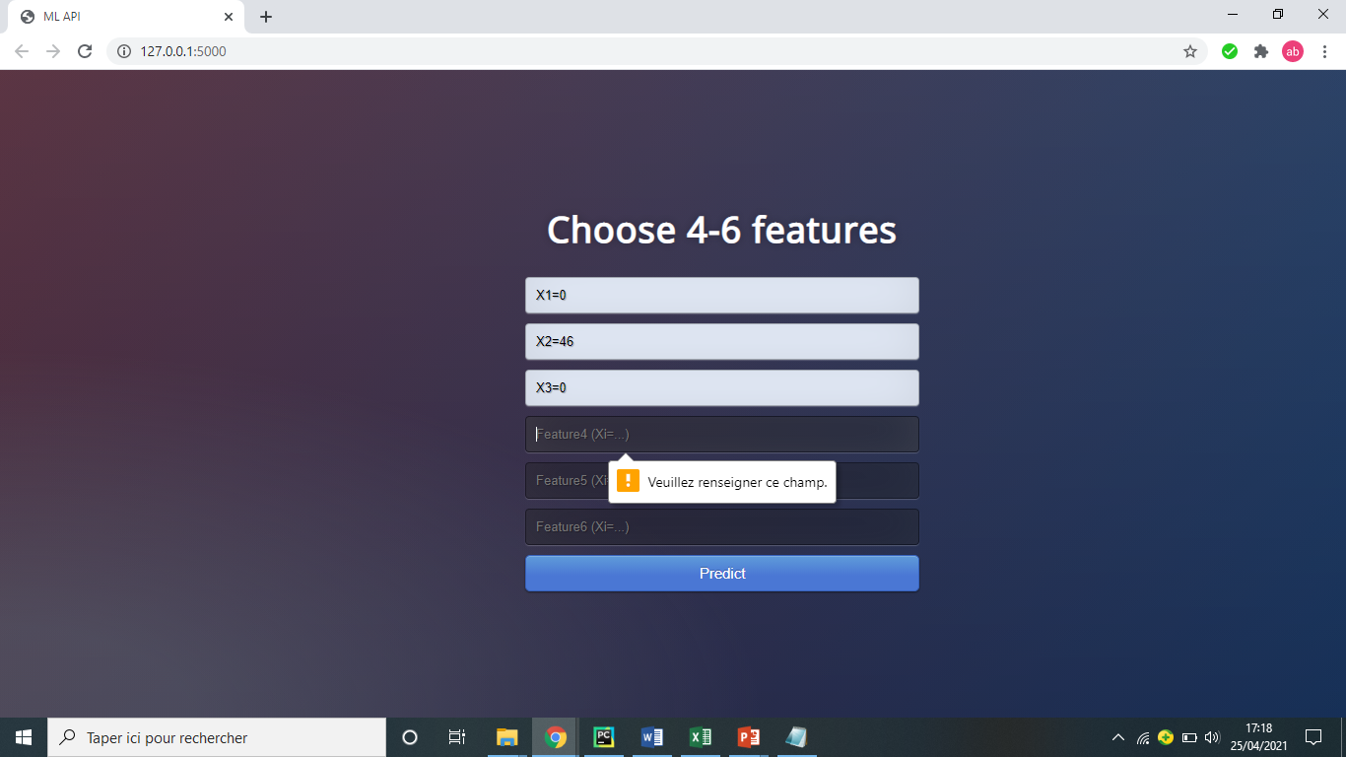

Slide 12
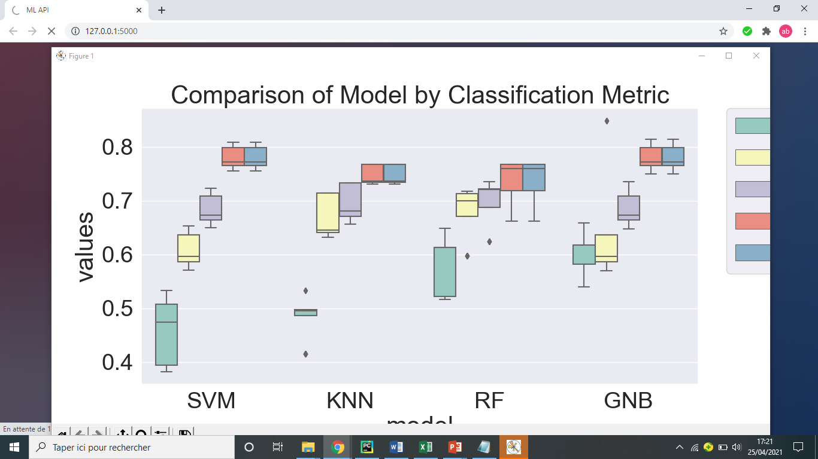

Slide 13
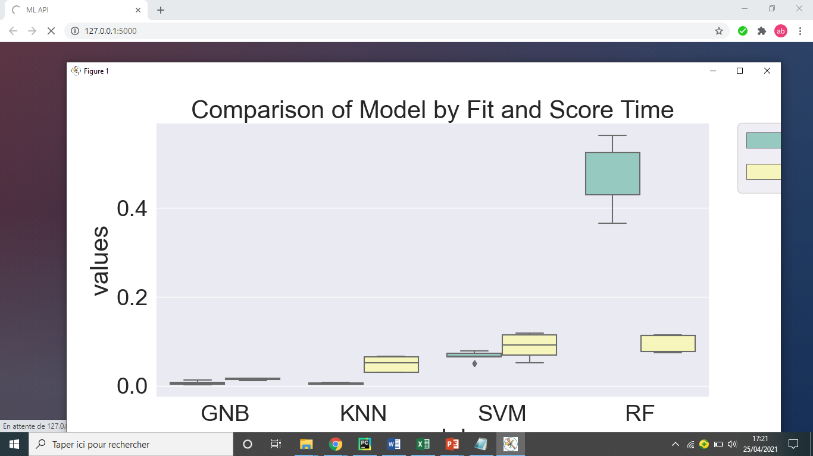

Slide 14
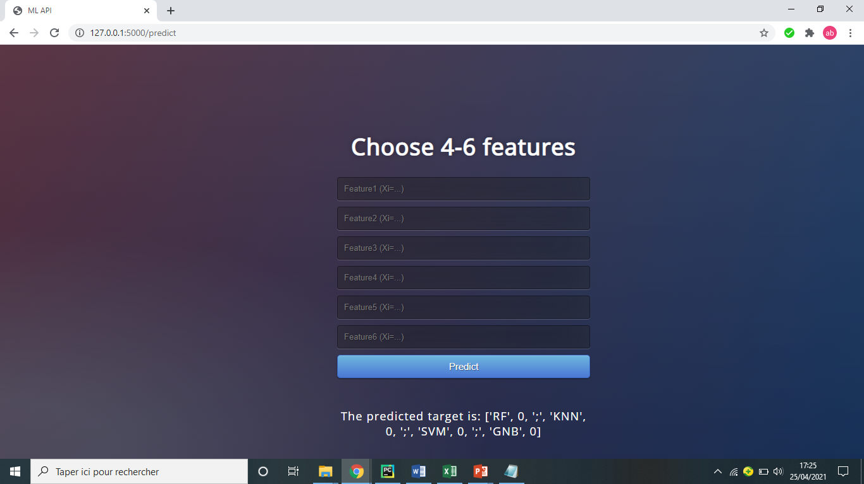

Slide 15
Thank you
15

